Slide 1
Analytics GC - Tape Gang
190100027 - Ashutosh Sharma
190100105 - Satdhruti Paul
200010066 - Aum Samel
OHLC Data Analysis with Pattern Mining and LSTM neural Models.

Slide 2
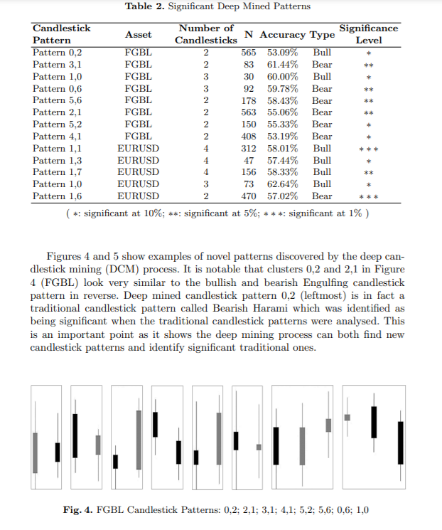
Problem Statement And Data Mining from Candlestick Patterns
OHLC data has been given and the correlation matrix of it vs given y was almost zero, but after introducing the high significance parameters from this paper we were able to get time dependent variables which were giving better correlation values hence we proceeded with them. Variables introduced: Bull Harami Pattern matches, Close of last < Open of new, Pattern 0,2 from paper on left, and Close > 50% of Prev Candle Height

Slide 3
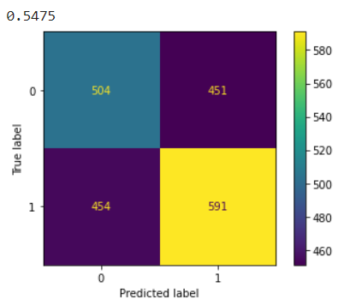
Initial Analysis with RF, Logistic and SVM regressions.
Since our variables are binary, we did not apply normalization as we would lose out on data.
Random Forest Accuracy = 54.75
Logistic Regression = 54.85
SVM accuracy = 54.75
XGBoost = 54.9
These were not above the 55% accuracy point that was required to be a decent model.
Hence we proceed to use LSTM RNNs as it is a time dependent data series.
We believe y represents increase or decrease in momentum(which represents acceleration in the stock price). If stock price is accelerating, y=1. This hypothesis was tested on the dataset by calculating acceleration in stock price as p(i-1) + p(i+1) - 2*p(i). If this quantity is positive, y is 1 and vice-versa. P here represents stock price calculated as mean stock price at ith time point.

Slide 4
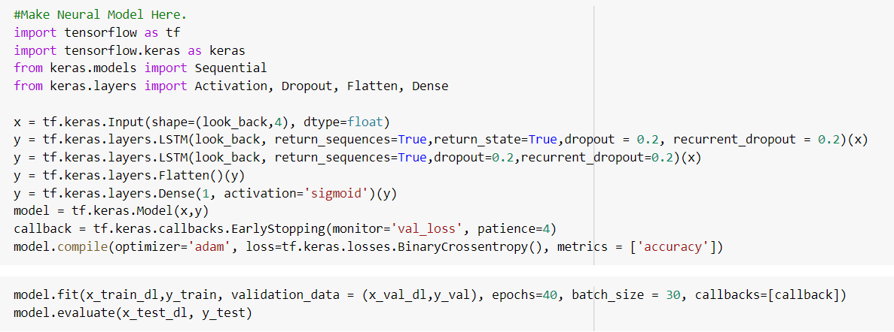
Deep Learning based approach
Since it was a time series data, LSTM based model was used with a special feature for look_out which controlled the amount of time series data required for a single data point for capturing the temporal relation with y.
Various heuristics and hyper parameter tuning resulted in accuracy on test dataset to be around 56.3% (higher than ensemble accuracies)

Slide 5
References
Deep Candlestick Mining - https://discovery.ucl.ac.uk/id/eprint/10062933/1/ICONIP_Deep_Candlestick_Mining_update_final.pdf,
Mid Range Analysis - https://discovery.ucl.ac.uk/id/eprint/10063445/1/Mann_A%20New%20Methodology%20to%20Exploit%20Predictive%20Power%20in%20(Open%20High%20Low%20Close.._.pdf
And sklearn documentation for different regression hyperparameters.
LSTM based approach - https://machinelearningmastery.com/sequence-classification-lstm-recurrent-neural-networks-python-keras/

